Slide 1

Moxie Devices Pvt. Ltd.
Beyond Boundaries

Slide 2
About US
  Specialization in design and manufacturing of Electronics circuits like AC-DC Adaptors, LED Drivers and Solar Energy based products like Solar LED lantern/ solar mobile charger.
  Working aggressively on new product Specifications to cater requirements for In-door & Out-door lighting applications.
  The strength of Moxie devices lies in understanding the challenges & catering the right solutions with right consultancy to its clients.
  Our Vision is to become a trusted partner with all our clients.
Notes:
www.moxiedevices.com

Slide 3
Agenda
Energy Aware Survey on Mobile chargers
Adaptor Product Portfolio
Test & Measurement Setup
Comparative Landscape
Selection Criteria for Mobile Charger
Upcoming Design
Complete Product Portfolio
Notes:
www.moxiedevices.com

Slide 4

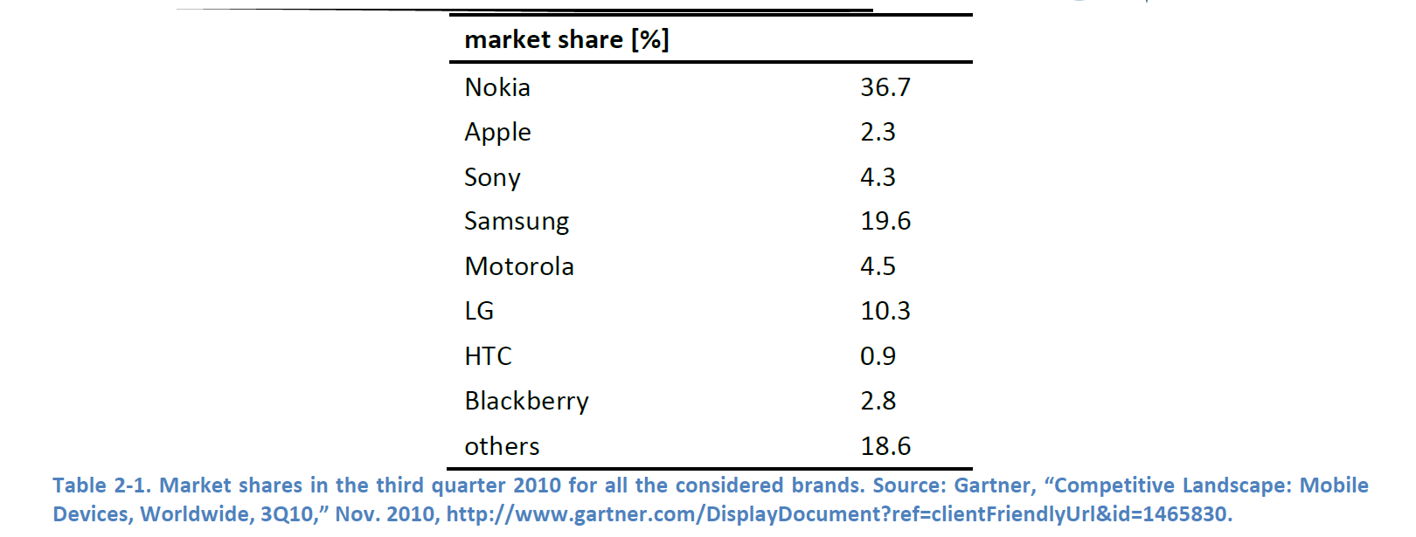
Survey on Mobile phone Charger

Slide 5
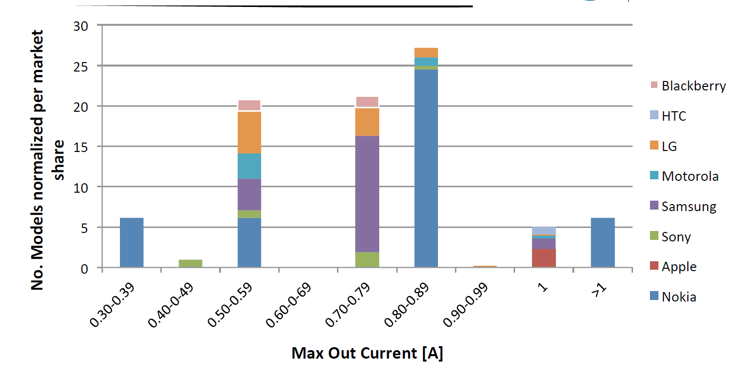
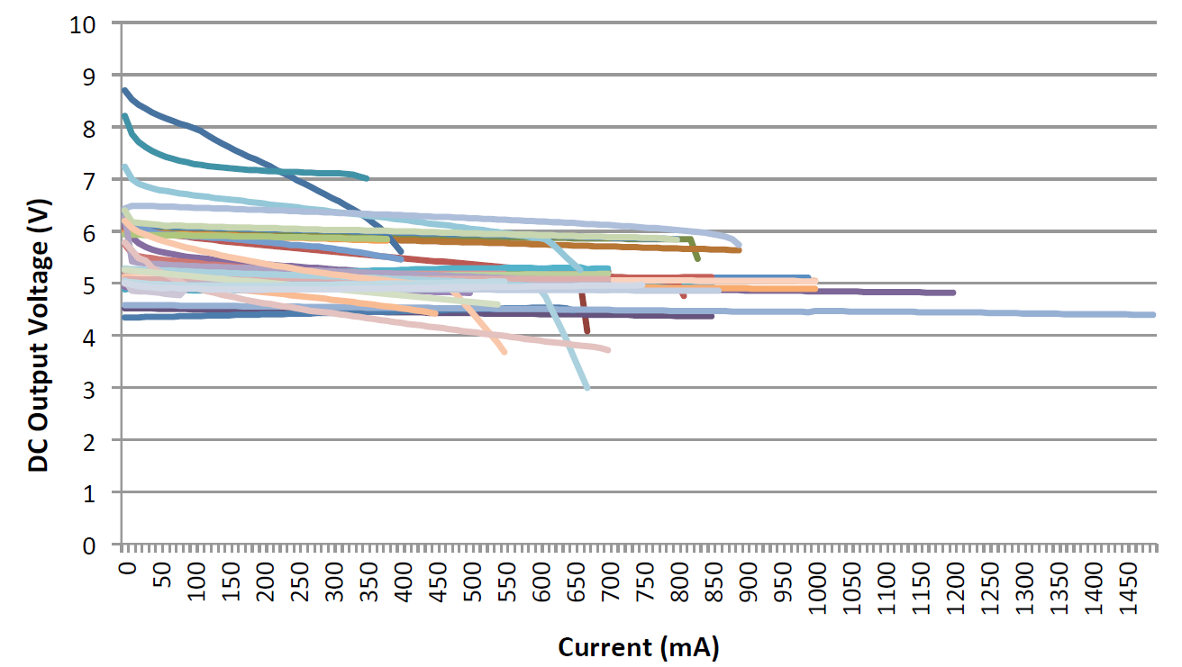
DC Output Current/Voltage
Sample number of chargers =117
* Study from Gartner
Notes:
This is to emphasize that maximum output current delivering is of the range form 0.5 to 0.9A
www.moxiedevices.com

Slide 6
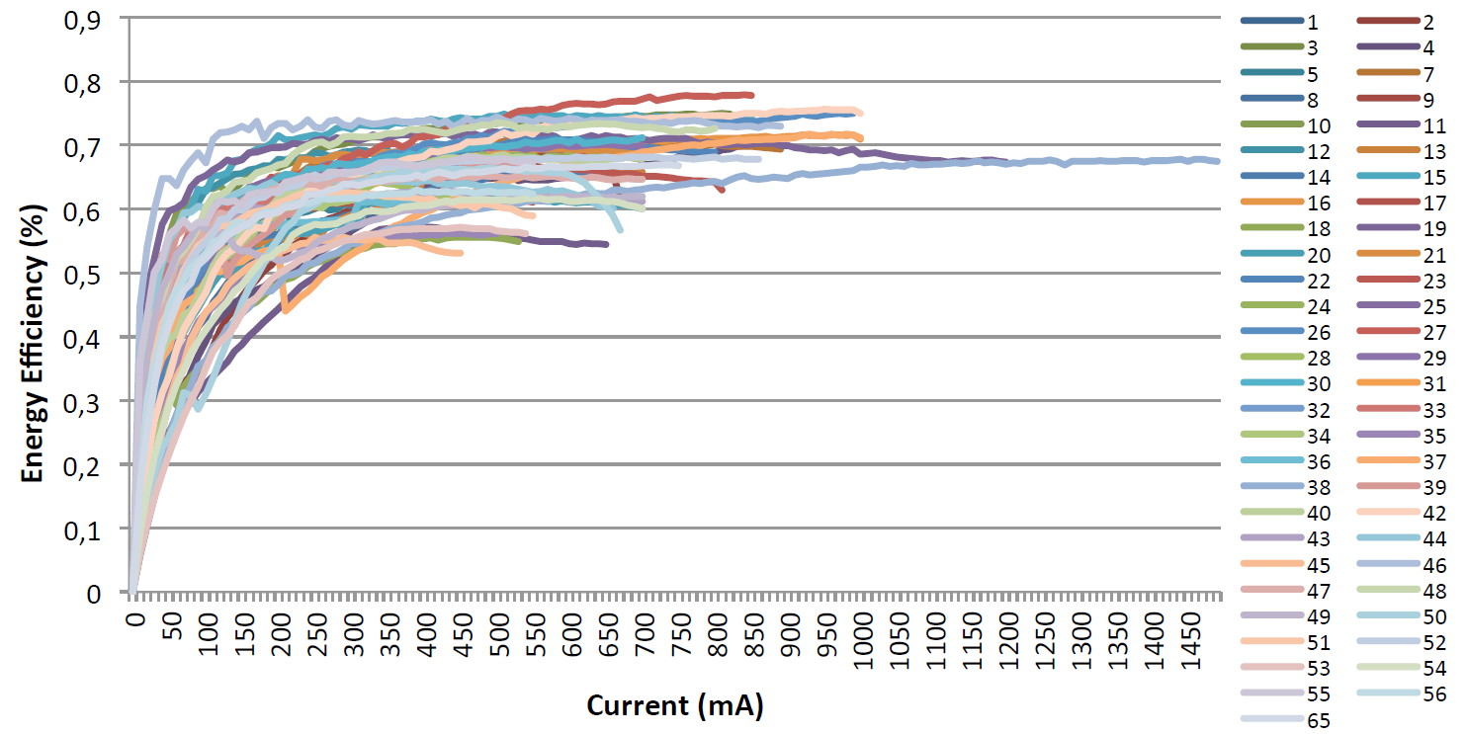
Energy Efficiency
Notes:
Energy Efficiency cluster is around 65-75%
www.moxiedevices.com

Slide 7
Agenda
Energy Aware Survey on Mobile chargers
Adaptor Product Portfolio
Test & Measurement Setup
Competition Landscape
Selection Criteria for Mobile Charger
Upcoming Design
Complete Product Portfolio

Slide 8
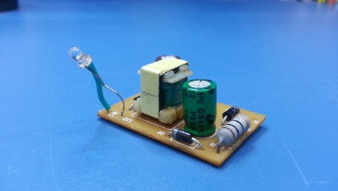
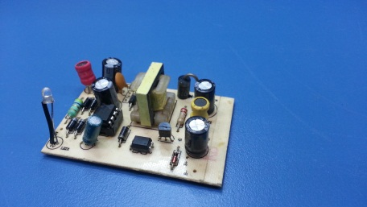
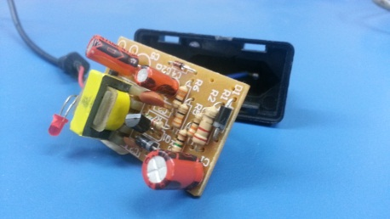
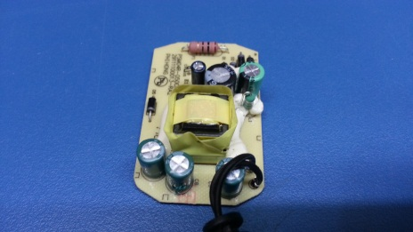
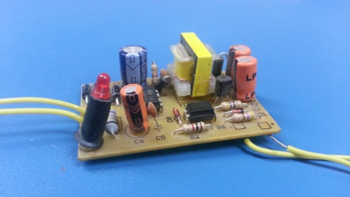
Adaptor Product Portfolio
A-AD025L
A-AD040V-A8
A-AD015T
BB-9680
A-AD040V-B8
* Images correspond to real physical boards

Slide 9
Agenda
Energy Aware Survey on Mobile chargers
Adaptor Product Portfolio
Test & Measurement Setup
Comparative Landscape
Selection Criteria for Mobile Charger
Upcoming Design
Complete Product Portfolio

Slide 10
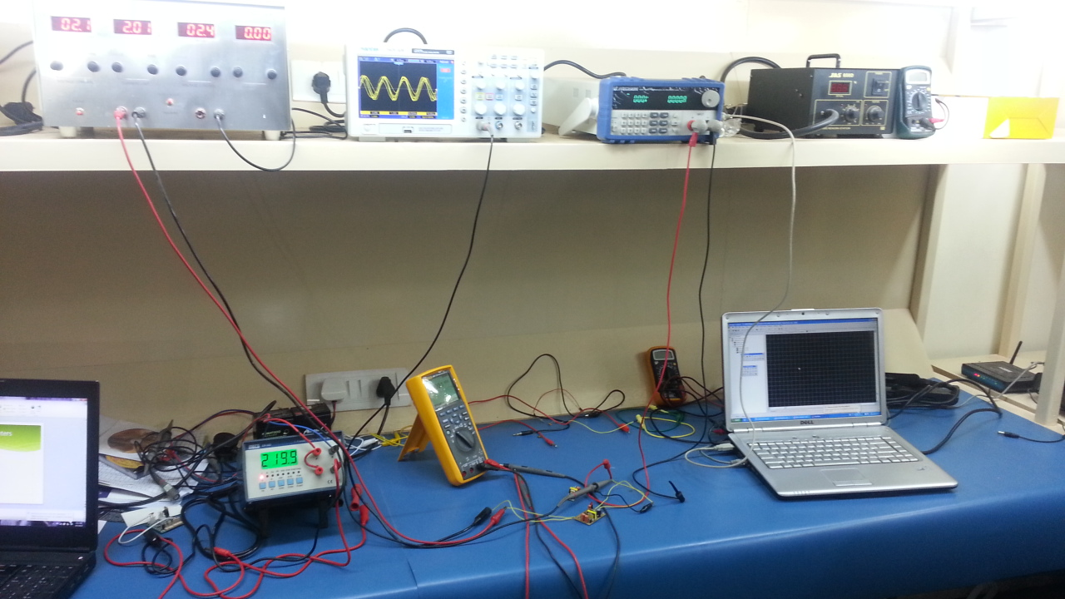
Test-Setup

Slide 11
Characterization handles
Input | Output | Protection
Efficiency | Rated Current | Overload
Inrush Current | Rated Voltage | Thermal
Leakage Current | Rated Power | Short Circuit
AC Current | Ripple & Noise | Fault detection
 | Line Regulation | Safety Standards
 | Load Regulation

Slide 12
Agenda
Energy Aware Survey on Mobile chargers
Adaptor Product Portfolio
Test & Measurement Setup
Comparative Landscape
Selection Criteria for Mobile Charger
Upcoming Design
Complete Product Portfolio

Slide 13
Comparative Landscape
Model No. | Rated Cur. | Rated Vol. | Rated Power | Ripple & Noise | Line Reg. | Load Reg. | Efficiency | Inrush Cur. | Leakage Cur. | AC Cur. | Protection Type
A-ADT015 | 0.3 | 5.0 | 1.5 | 0.16 | +/-10% | +/-10% | 0.34 | 3 | 0.004 | 0.025 | NA
A-ADL025 | 0.45 | 5.5 | 2.5 | 0.19 | +/-1% | +/-3% | 0.81 | 6 | 0.001 | 0.002 | Overload Fault Detection Over temperature
A-ADV04-A8 | 0.5 | 8.2 | 4 | .408 | +/-1% | +/-3% | 0.7 | 2 | 0.002 | 0.02 | Overload Over temperature Overvoltage with Auto restart
A-ADV04-B8 | 0.5 | 8.2 | 4 | .150 | +-1% | +/-3% | 0.75 | 0.6 | 0.004 | 0.05 | Overload Over temperature Overvoltage with Auto restart
BB | 0.7 | 5 | 3.5 | .025 | +-1% | +/-0.5% | 0.75 | 3.5 | 0.002 | 0.04 | Overload Fault Detection Over temperature

Slide 14
Agenda
Energy Aware Survey on Mobile chargers
Adaptor Product Portfolio
Test & Measurement Setup
Comparative Landscape
Selection Criteria for Mobile Charger
Upcoming Design
Complete Product Portfolio

Slide 15
Cost vs Quality vs power
A-ADV035
BB
????
A-ADV04-A8
A-ADV04-B8
Quality (Regulation)
Power
????
A-ADL025
A-ADT015
cost

Slide 16
Agenda
Energy Aware Survey on Mobile chargers
Adaptor Product Portfolio
Test & Measurement Setup
Comparative Landscape
Selection Criteria for Mobile Charger
Upcoming Design
Complete Product Portfolio

Slide 17
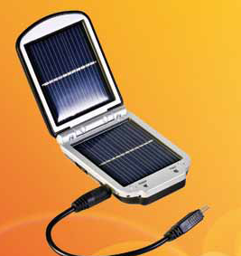
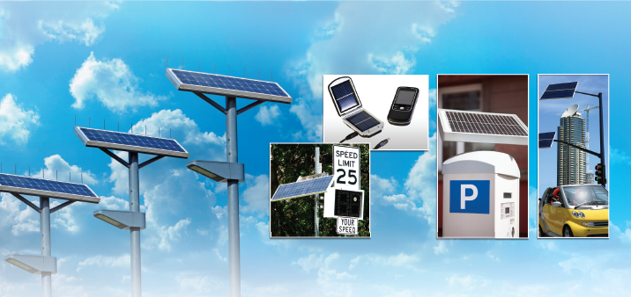
Solar based Solutions

Slide 18
Solar based Mobile Charger
Low power, low voltage
0.3 V up to 5.5 V input operating
2v up to 5.2 V output voltage regulation
1.8 A maximum output current
155 ºC over-temperature shutdown
Embedded MPPT algorithm

Slide 19
Prototyping

Slide 20
Agenda
Energy Aware Survey on Mobile chargers
Adaptor Product Portfolio
Test & Measurement Setup
Comparative Landscape
Selection Criteria for Mobile Charger
Upcoming Design
Complete Product Portfolio

Slide 21
Product Portfolio
Put a complete portfolio with a Mix of pics/text
LED Drivers/Adaptors/Solar lantern/ LED Bulb

Slide 22
Thank You
Moxie Devices Pvt. Ltd.
G-212, Sector 63, Noida – 201301
Phone: 8860497497 8800236052
Email: contact@moxiedevices.com
Website: www.moxiedevices.com

